Slide 1
CGS 616
SEARCH PROJECT
BY-
ARNAV KUMAR ( 200187 )
JIYANSHU DHAKA ( 220481 )
VIKRAM KUMAR (231280003 )

Slide 2
INTRODUCTION
Options: We have done both Option 1 and 2.
AIM: Our aim with this project was to analyse the cognitive behaviour of the person with respect to their overall interests while surfing on web.
In Option 1: Analysis for Every Hour and generating within day prediction for next hour
We made the analysis hour wise similar to day wise and then we used Random Forest classifier for Generate within-day predictions for which topics are likely to be viewed in the coming hour.
In Option 2: Using LDA clustering algorithm for analysing Transition between Topics.
We have analysed all the transitions user was making using LDA clustering algorithm .We were Tracking the transition with dwell time as marker to see how long user was spending time on each topics before transiting to the next one.
Both options help us understand cognitive behaviour of user.

Slide 3
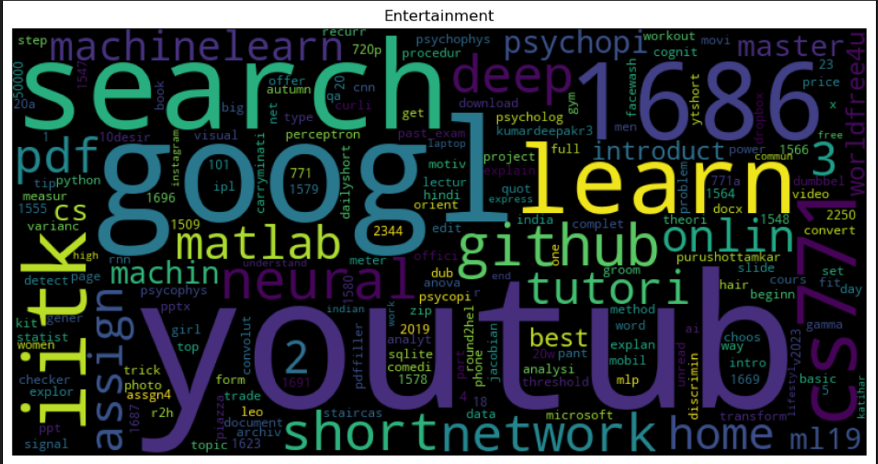
Topics for the project are: Topic#0 Entertainment

Slide 4
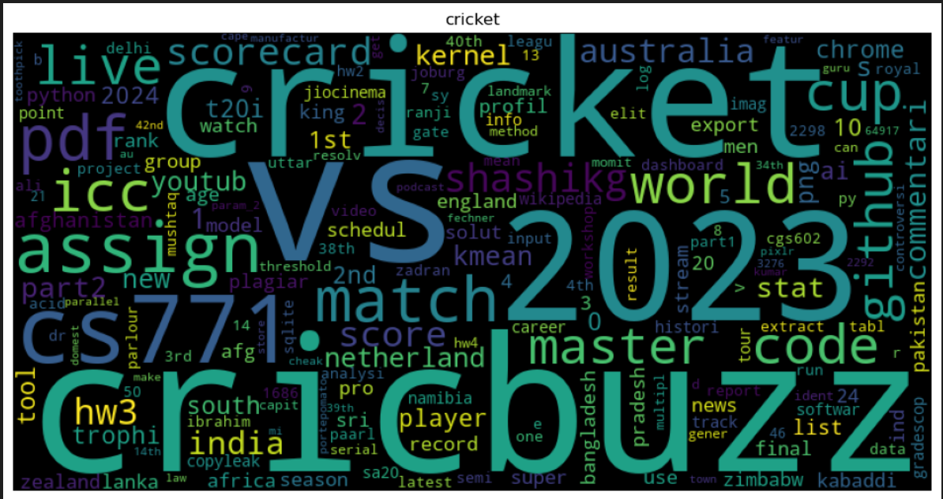
Topic#1 Cricket

Slide 5
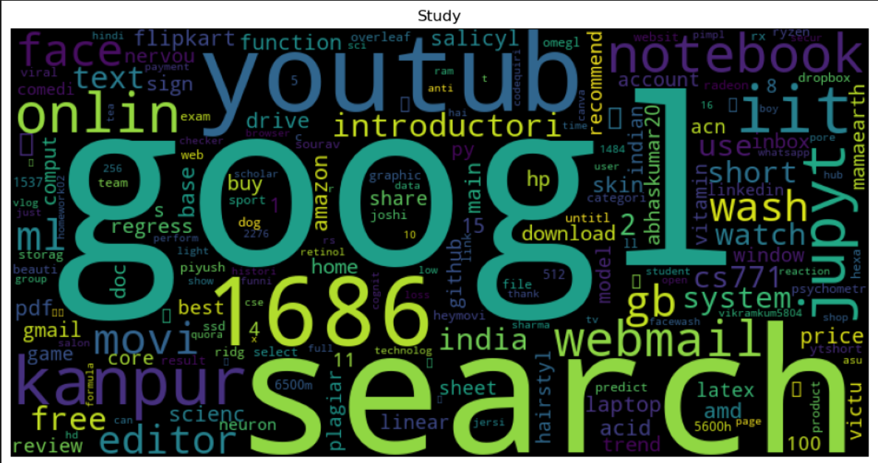
Topic#2 Study

Slide 6
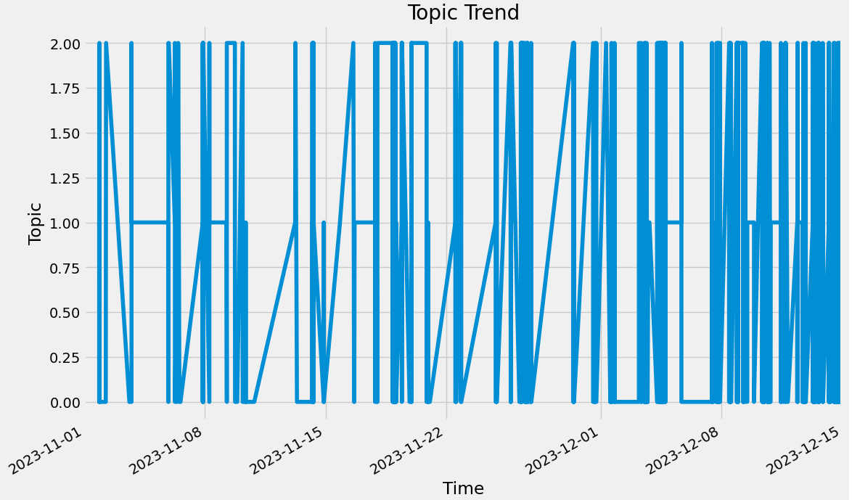
Topic transitions over time:

Slide 7
The transition graph above showcases how frequently there’s a switch between the topics certain conclusions that can be made out of this graph are:
Most surfed websites of the viewer is among topic 0 and topic 1
The transition frequency is increased towards the end of the year, portraying a holiday season as the viewer’s screen time increased rapidly.

Slide 8
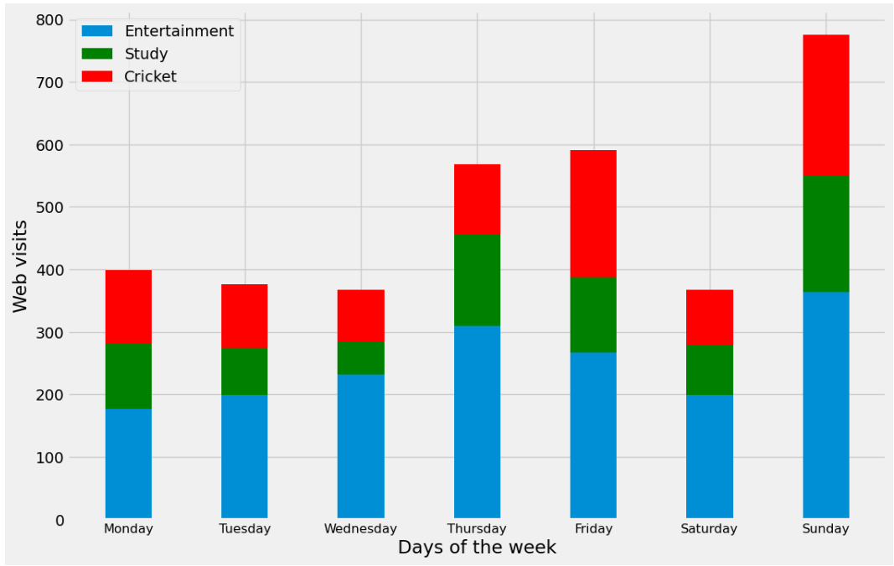
Web Visits Distribution Across Days of the Week:

Slide 9
Above showcases the day wise distribution of website visits in each topics and further conclusions can be made:
The topic 0 has the highest visits and is consistent on all the seven days followed by topic 1 and then 2.
Friday have highest screen time overall among other weekdays portraying that the viewer has a less work load.
Thursday seems to have second highest overall screen time on a week day including highest screen time for study, which shows a cognitive behaviour of the viewer that increase in the study duration on the screen eventually increases the screen time for entertainment as well.
The viewer makes much out of sunday as the number of web visits are relatively higher of all the three topics

Slide 10
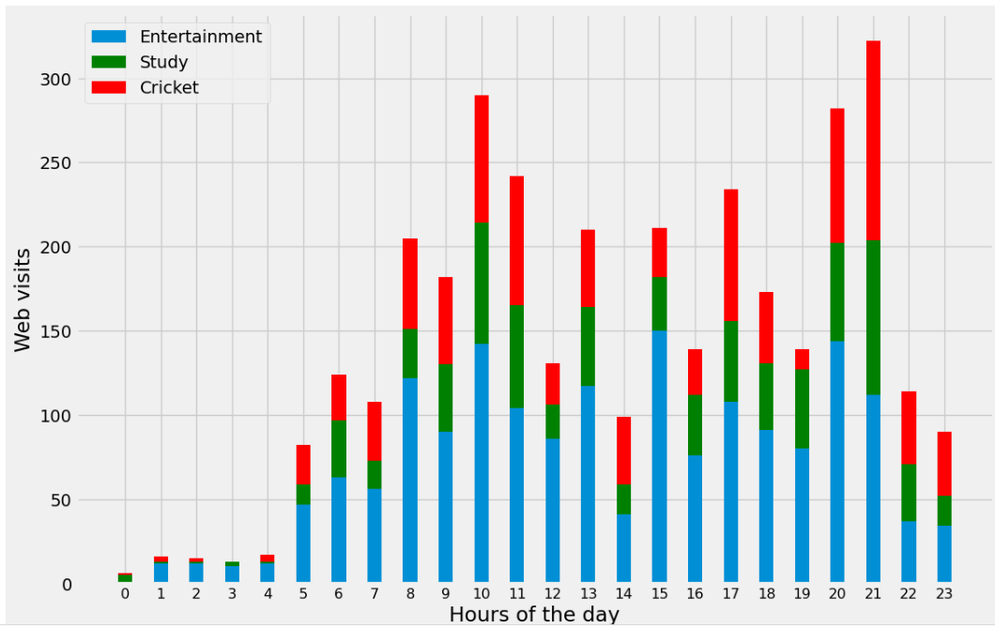
Option1: Web Visits Distribution Across Hours of the day:

Slide 11
Above showcases the hour wise distribution of website visits in each topics and further conclusions can be made:
The histogram gives a clear idea about the active hours of the viewer which is from 5 am to 11 pm.
Web visits around 2 pm are least during the day time shows the the viewer might have lunch in that period
Most active time throughout the day is at 9 pm, after that the web visits drastically decreases tells us the the bedtime just before sleep contributes most to the web visits.

Slide 12
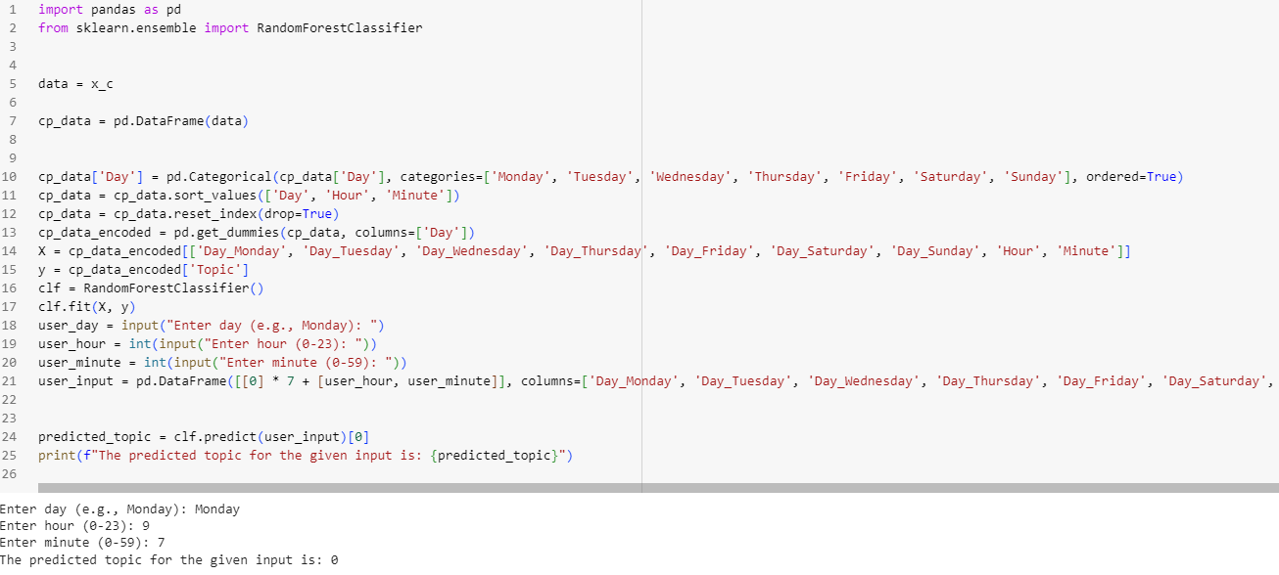
Topic Prediction using Random Forest Classifier:

Slide 13
Conclusion of prediction of topics
Random forest classifier was used because the data was very random so for solving regression and classification problem Random forest gives better results.
Random forests combines predictions from smaller models like decision tree.
randomforestclassifier function was used for our predictions
The model takes the day, hour and minute of the day and gives the current topic as output using random forest classifier.

Slide 14
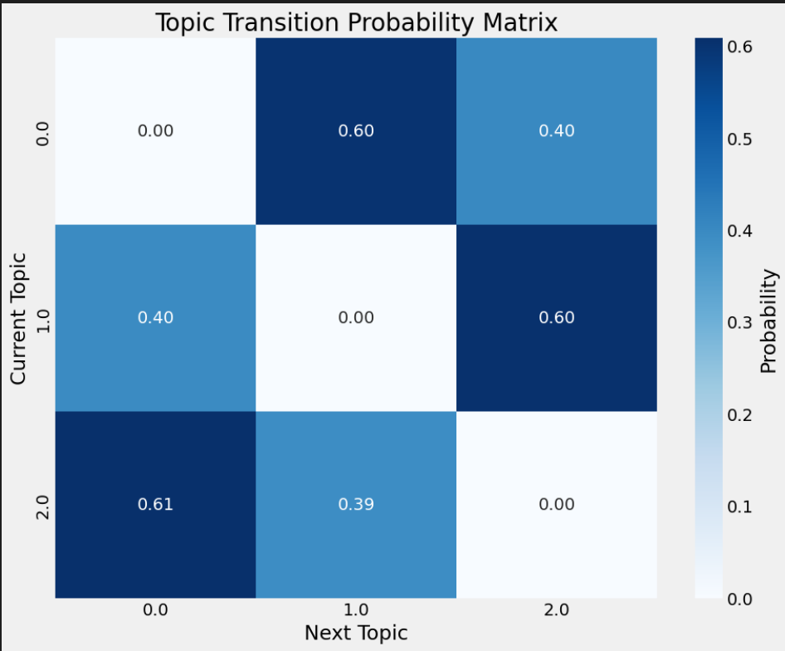
Option 2: Transition Probability Matrix:

Slide 15
The transition probability matrix
This matrix tells about the odds of the next topic on the basis of our current topic.
The user is more likely to switch from entertainment to cricket than study.
The user is more likely to switch from cricket to study than entertainment.
The user is more likely to switch from study to entertainment than cricket.

Slide 16
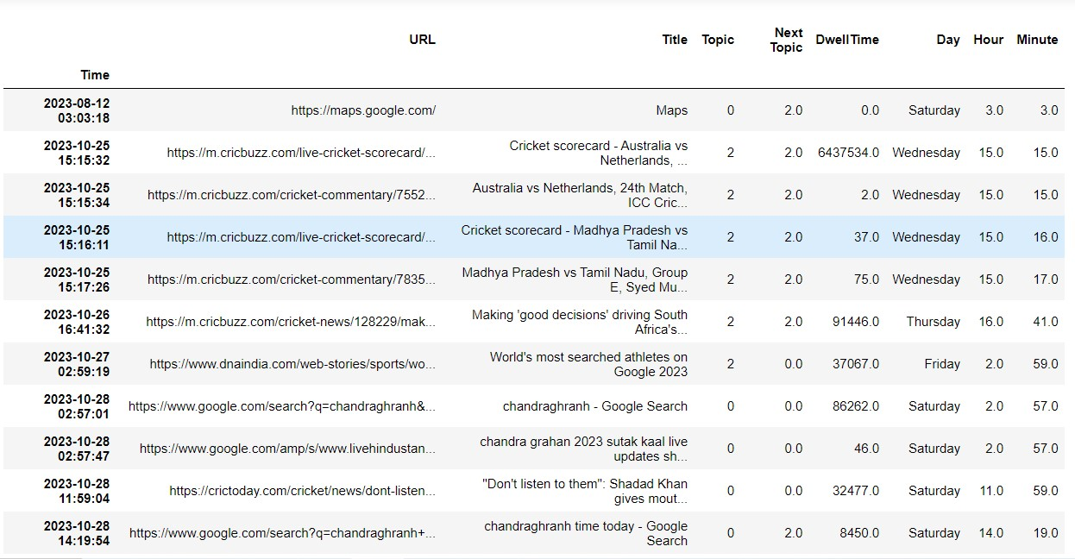
Data Frame including Topics, Dwell time, Day, Time & Hour.

Slide 17
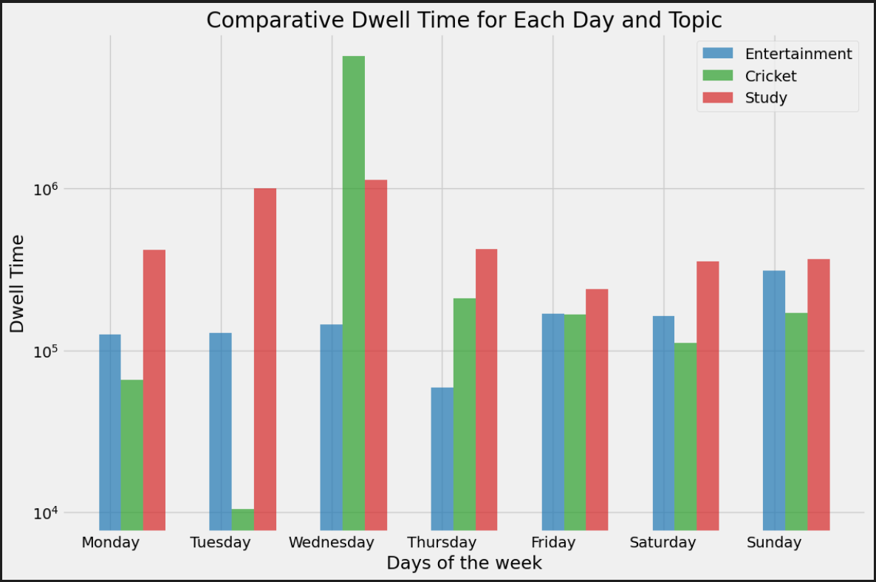
Dwell Time comparison for each day of the week:

Slide 18
Dwell Time comparison for each day of the week:
The dwell time suggests that the data about the web visits are totally opposite to the topics prevailing in terms of dwell time.
Viewer seems to be consistent with the study and entertainment throughout the week
Wednesday seems to be a cricket day but have least attention towards cricket on tuesday.
It seems the viewer pays good attention towards health along with their studies and other entertainments.

Slide 19
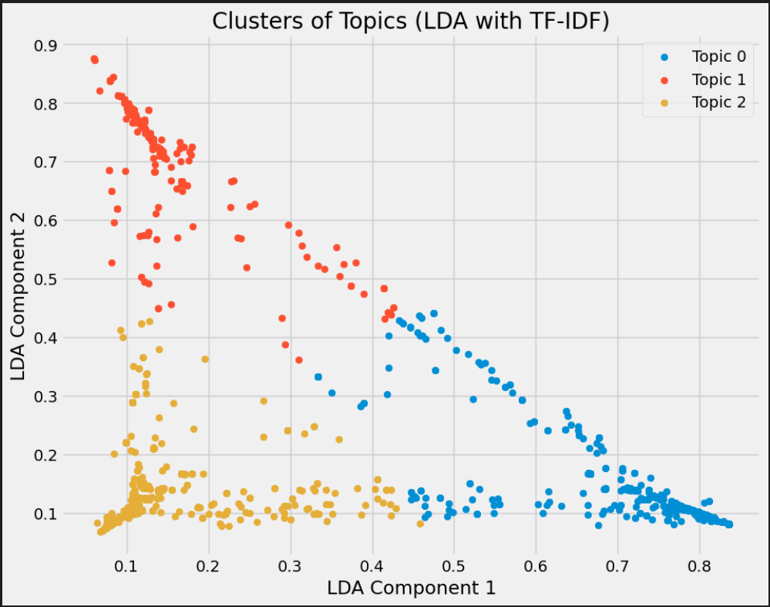
Implementing LDA clustering algorithm:

Slide 20
Latent Dirichet Allocation clustering for our dataset
The algorithms find a lower-dimensional subspace that maximizes the separation between different classes by finding linear combinations of features that maximize the separability between classes.
For some reason k means method was not giving satisfying results for this dataset so we had to use LDA clustering algorithm to make the clusters for the 3 topics.
We took dwell time and day of the week as the features for the algorithm then calculated within class scatter Matrix which consists of variance and mean of all the three topics.
For Study topic more numbers of points were more centred towards the mean of the topic because of more repeation of websites like Hello IITK, pingala, etc.

Slide 21
Collaborations:
Cognitive misers helped us to transition from our initial plans of implementing a research paper to pursuing option 2 and helped in making history text file.
Saugat Kannojia’s group helped us in code of transition probability matrix.
Sovan Sahoo’s group suggested that we should use Random Forest Classifier for better prediction of topics.
Sources
For LDA we used medium website
https://medium.com/@aneesha161994/linear-discriminant-analysis-lda-739113e22fbd

Slide 22
THANK YOU!!

